Slide 1
CFS Patients Beta Brains P-value < 0.05

Slide 2
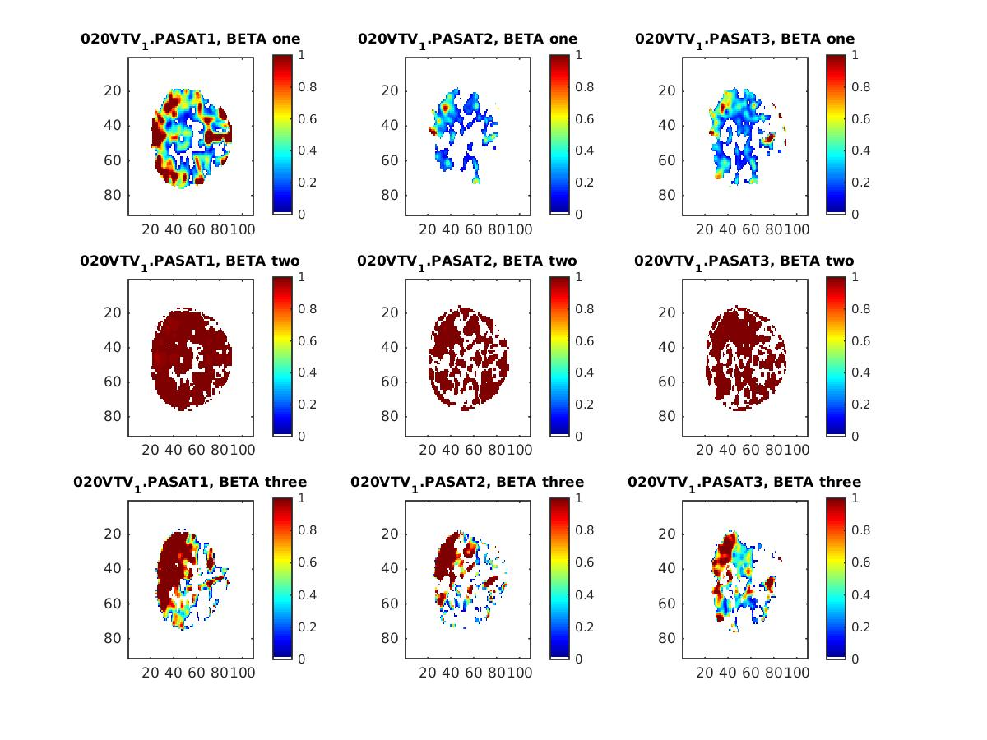

Slide 3
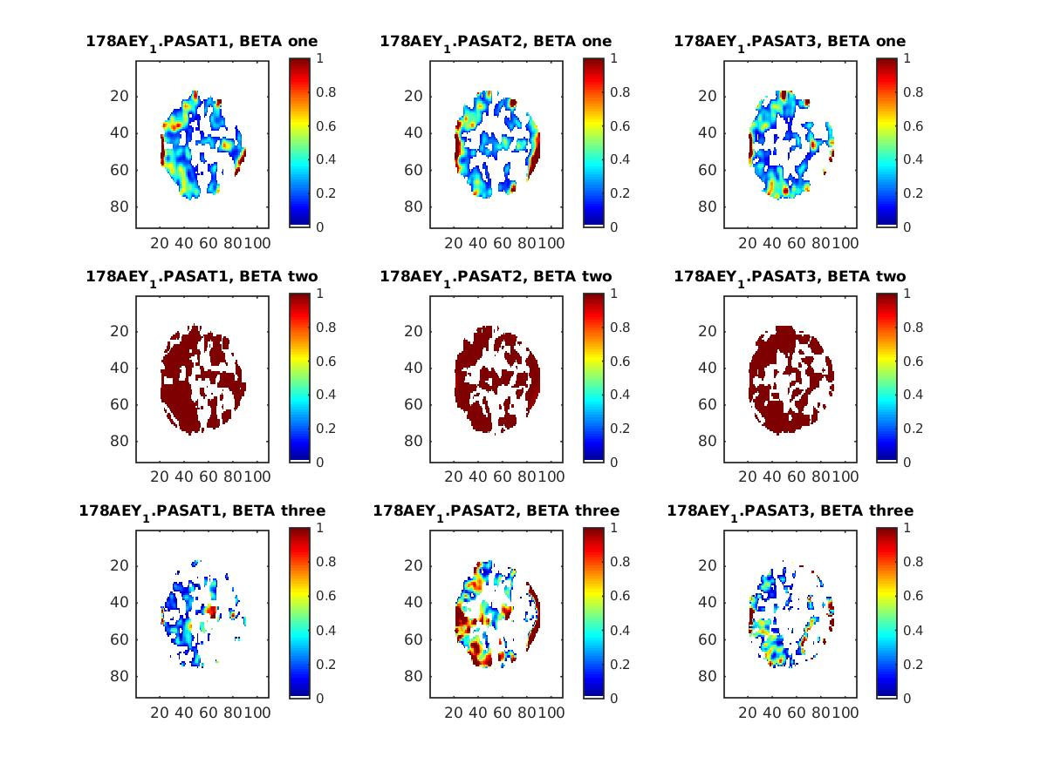

Slide 4
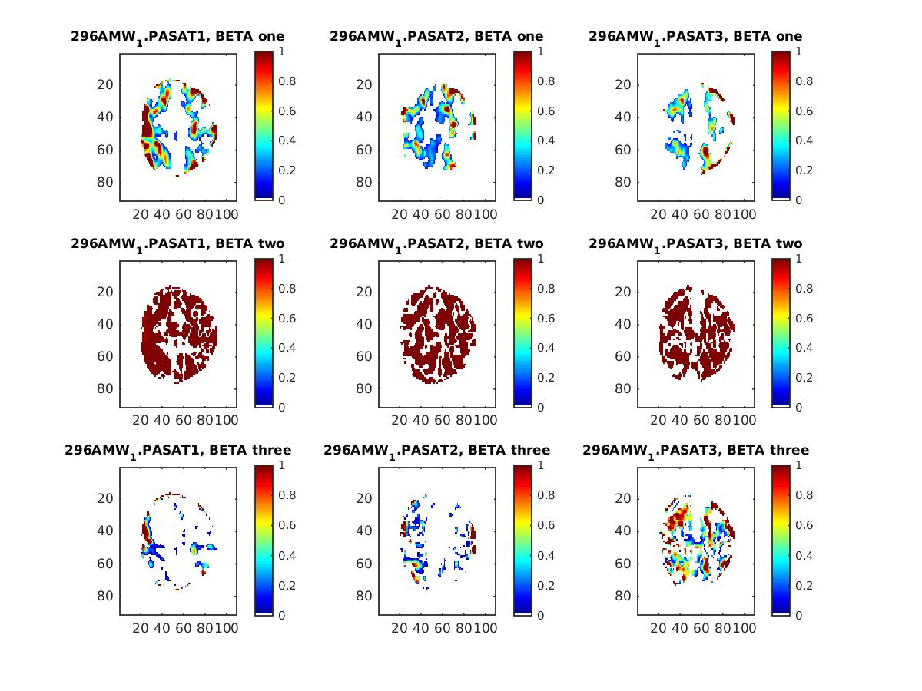

Slide 5
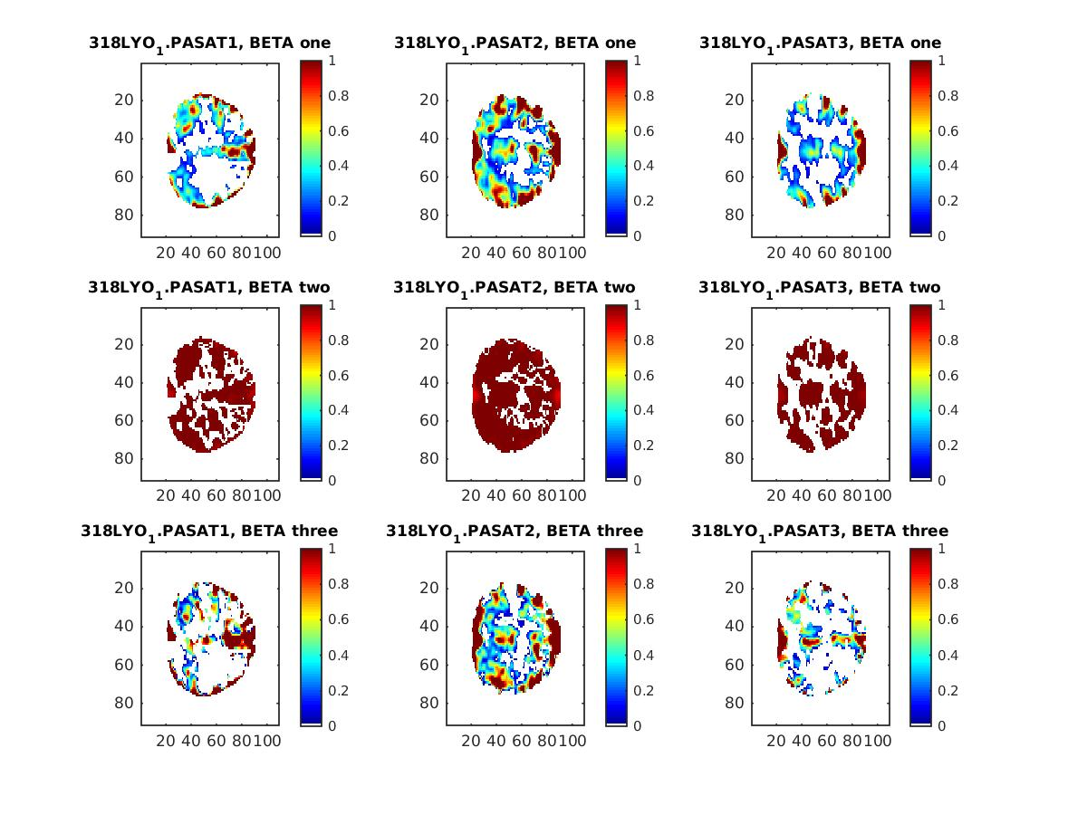

Slide 6
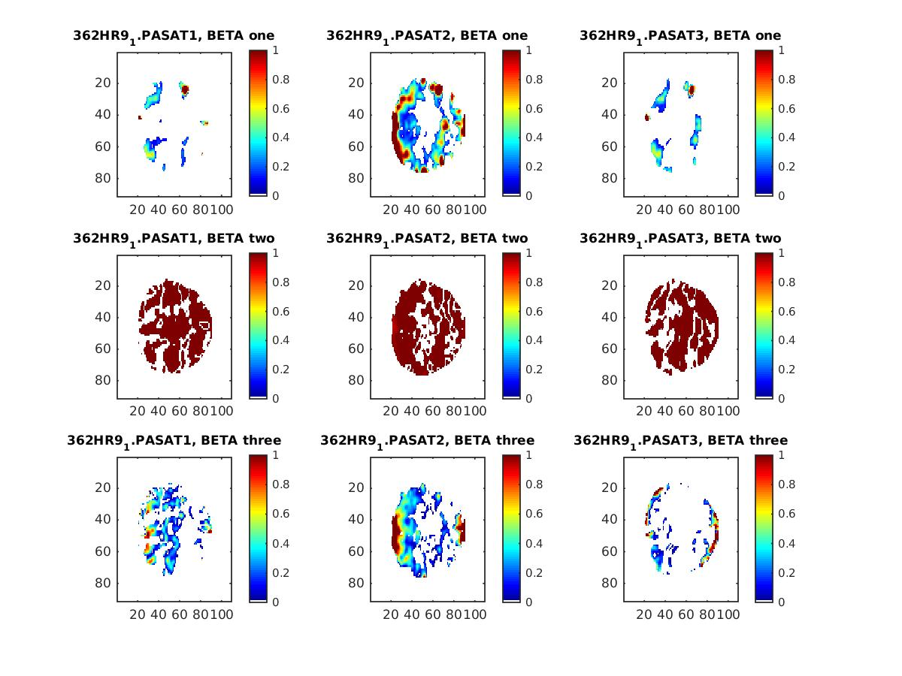

Slide 7
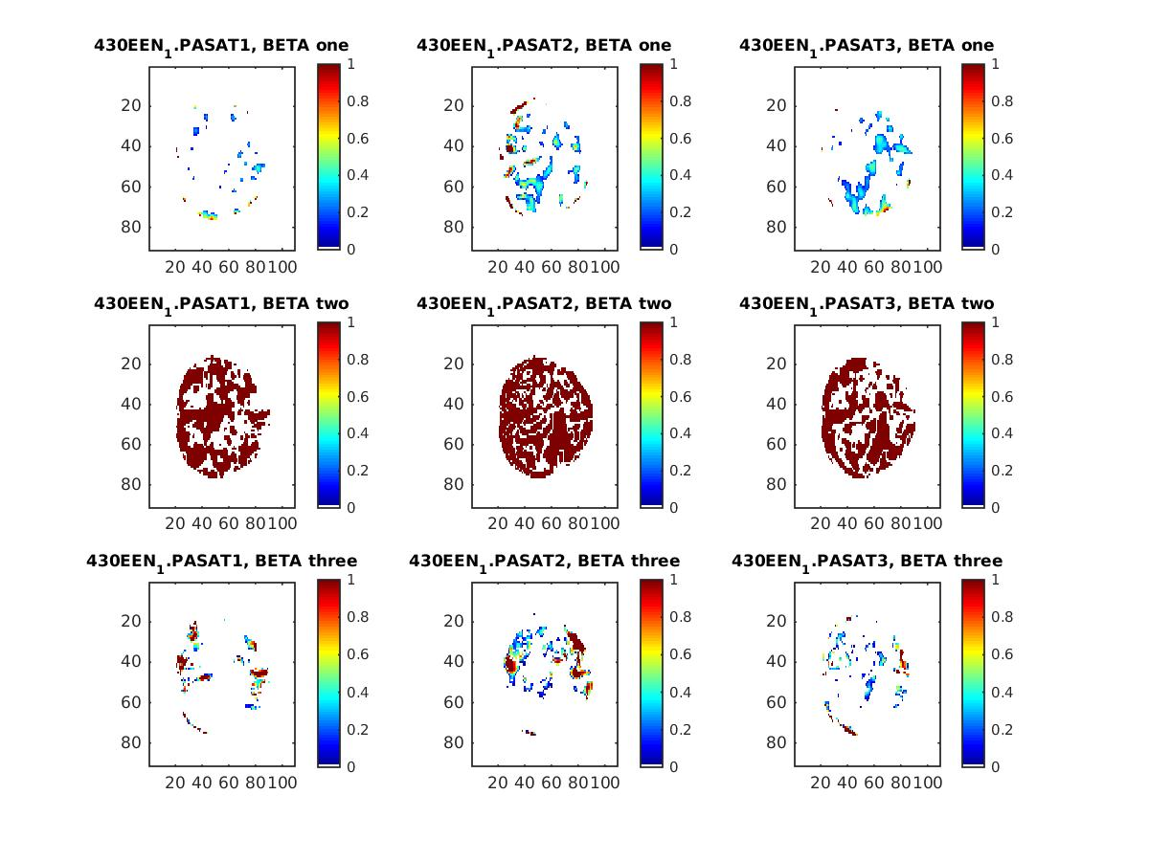

Slide 8
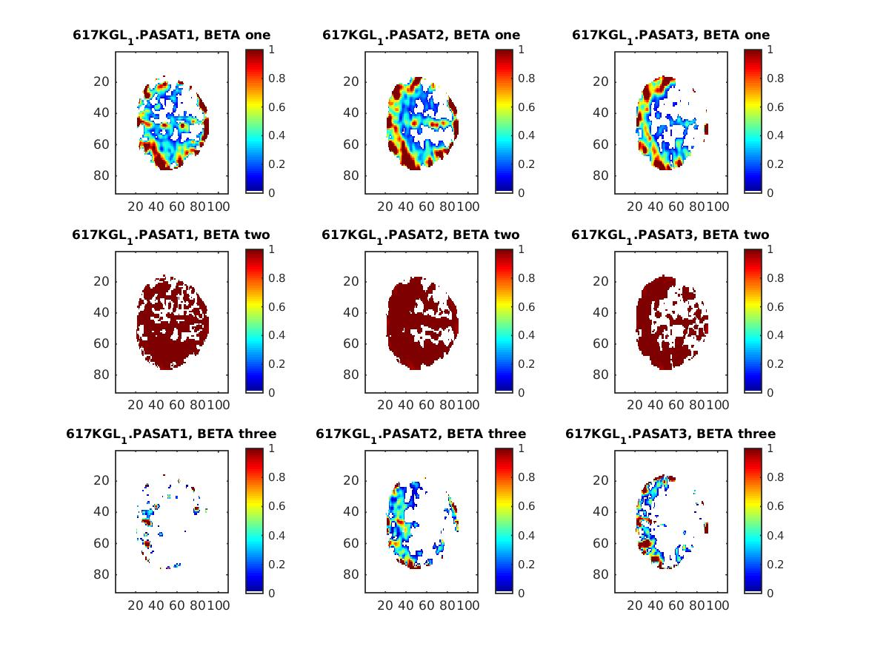

Slide 9
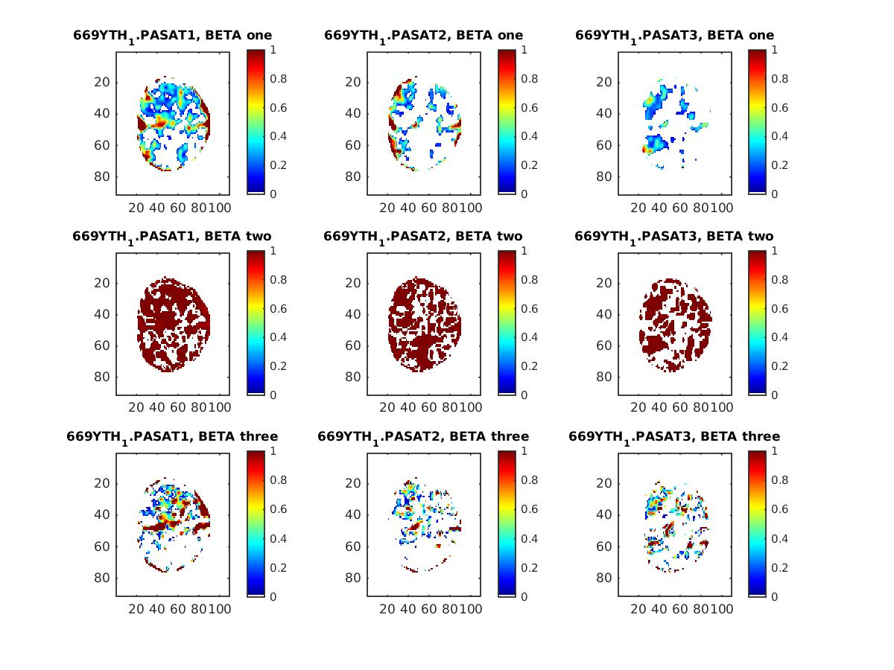

Slide 10
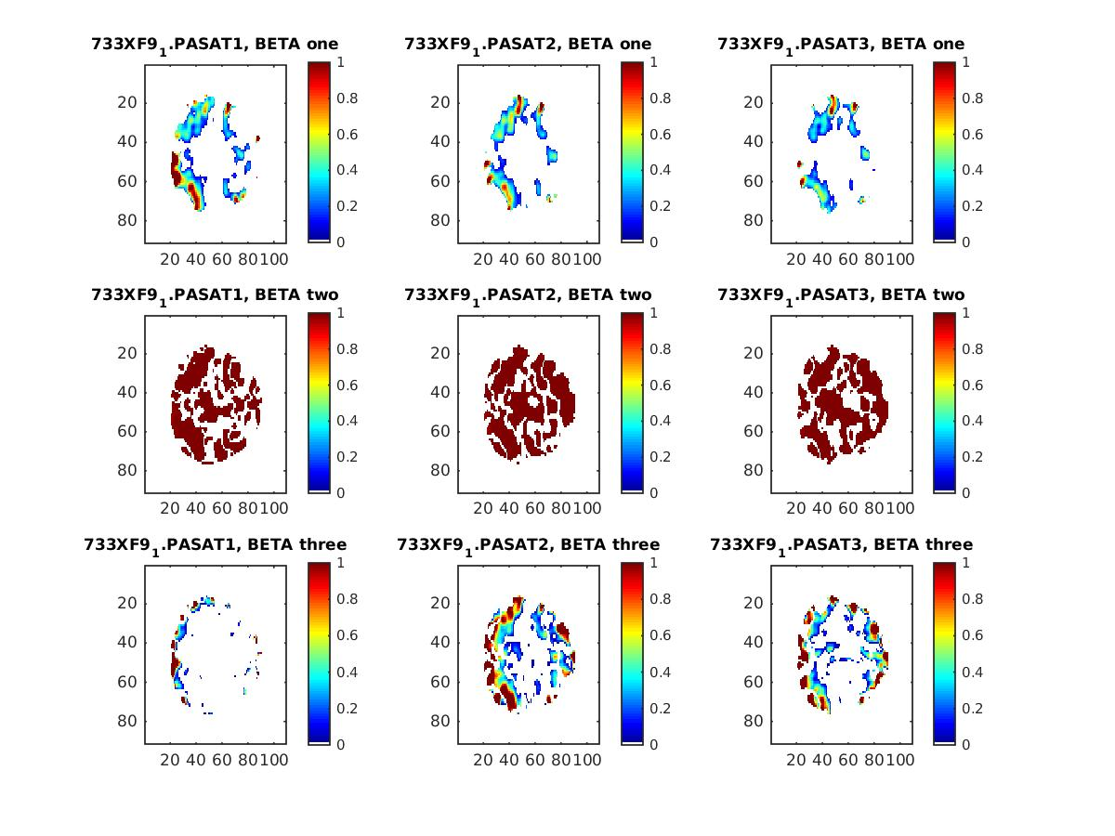

Slide 11
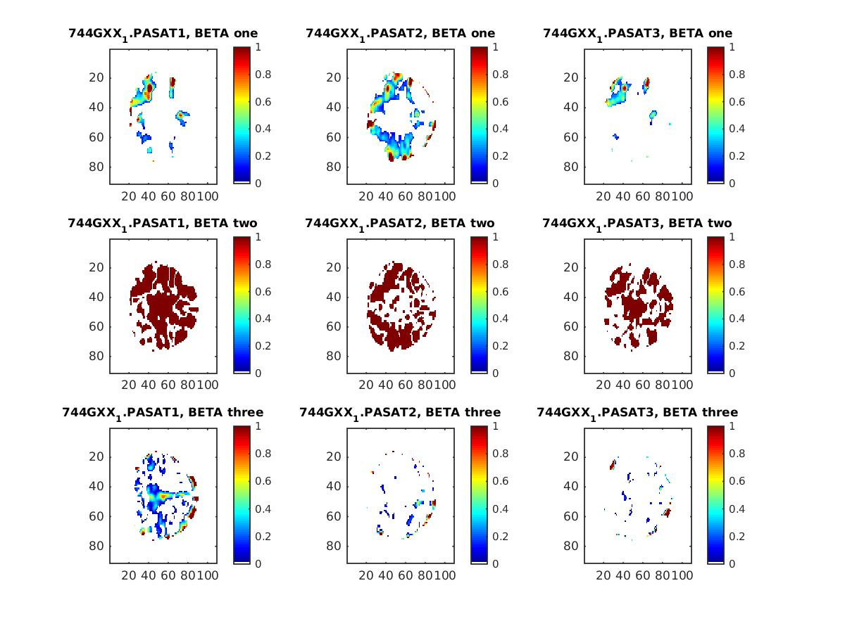

Slide 12
HC Patients Beta Brains P-value < 0.05

Slide 13
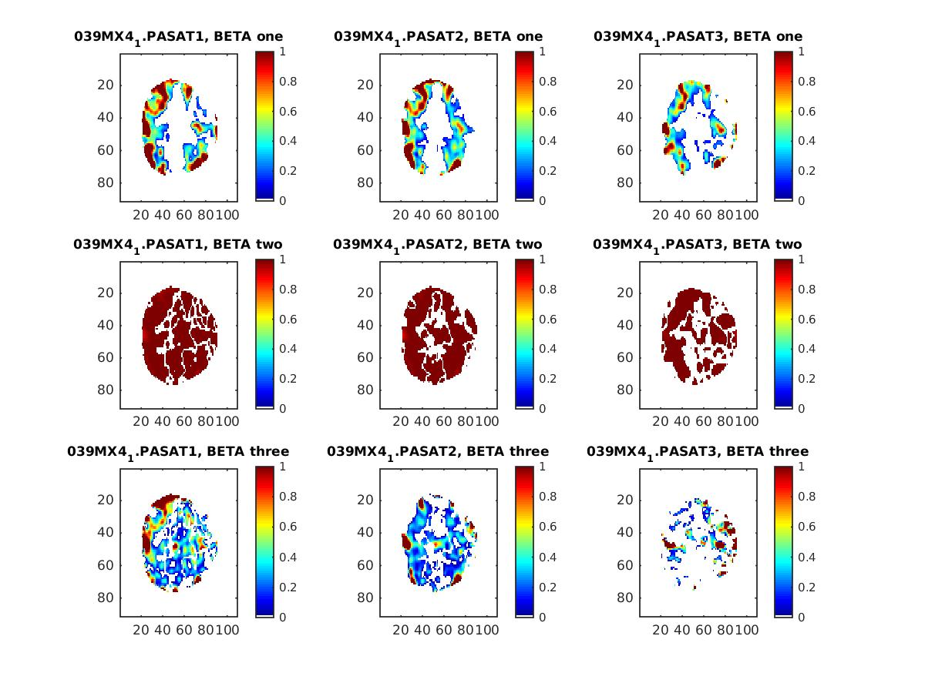

Slide 14
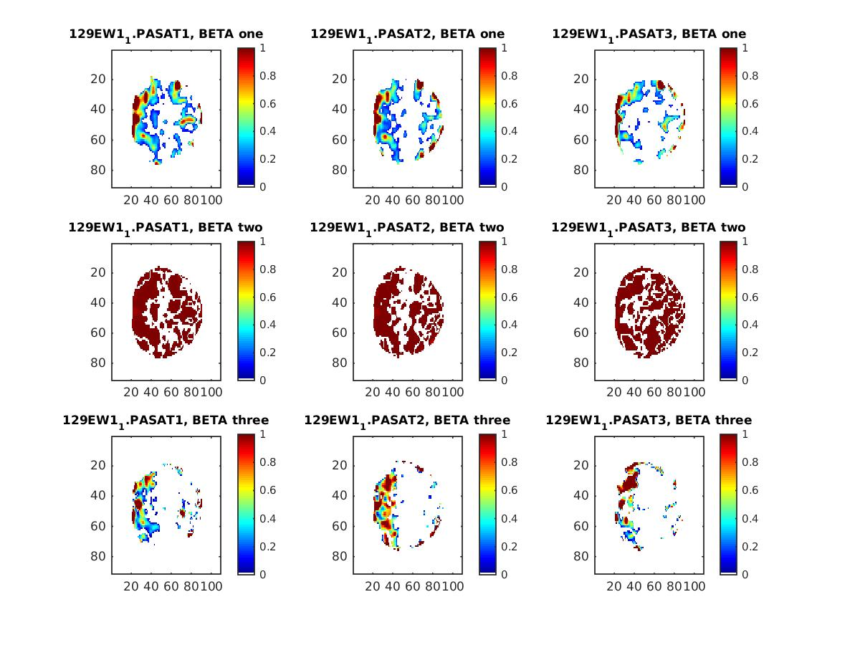

Slide 15
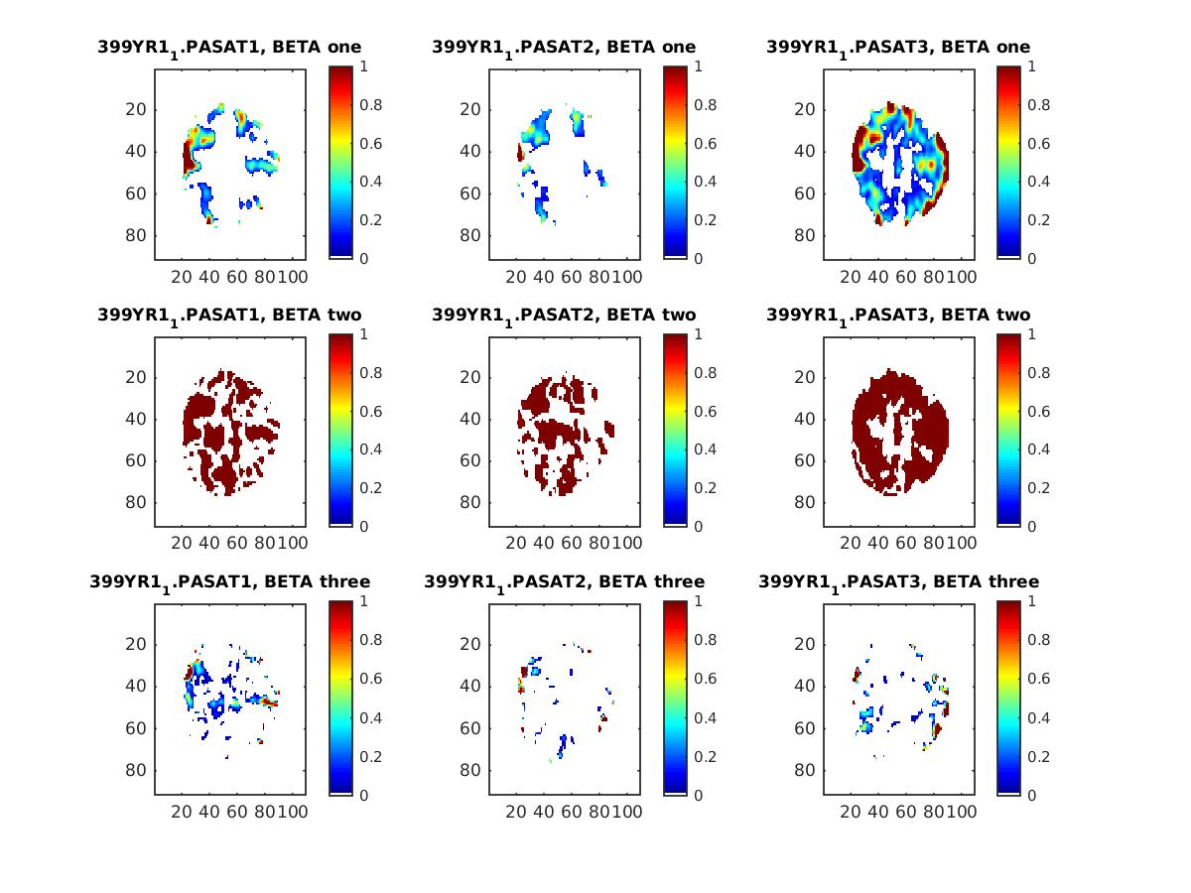

Slide 16
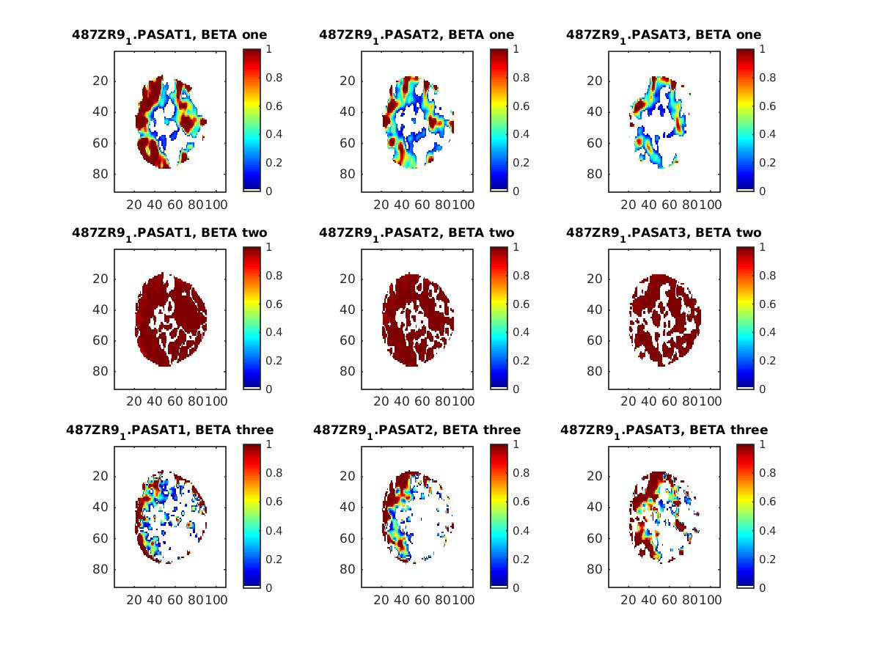

Slide 17
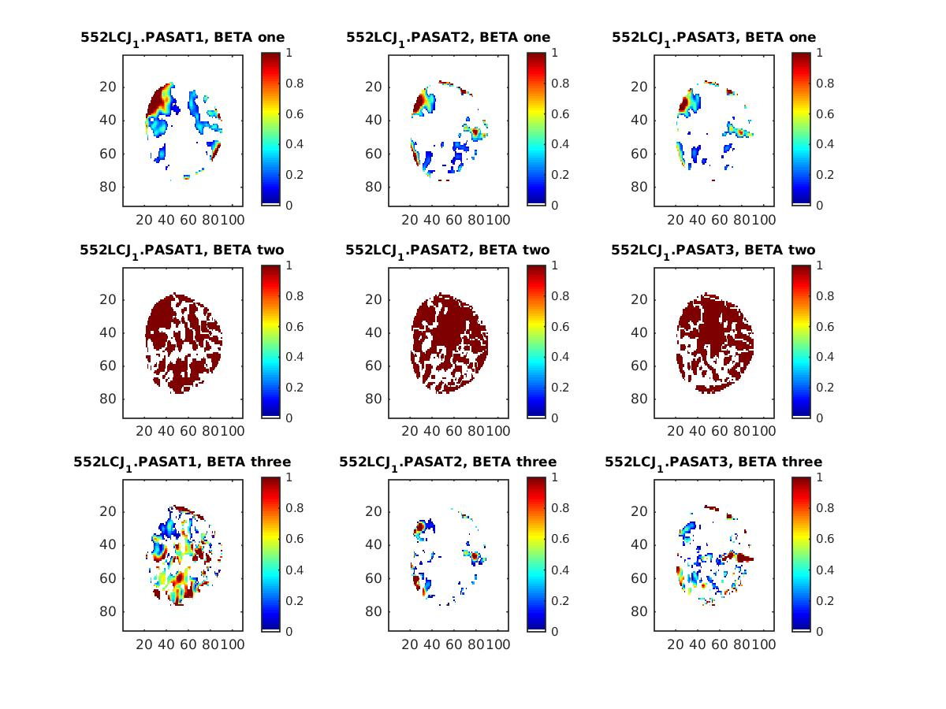

Slide 18
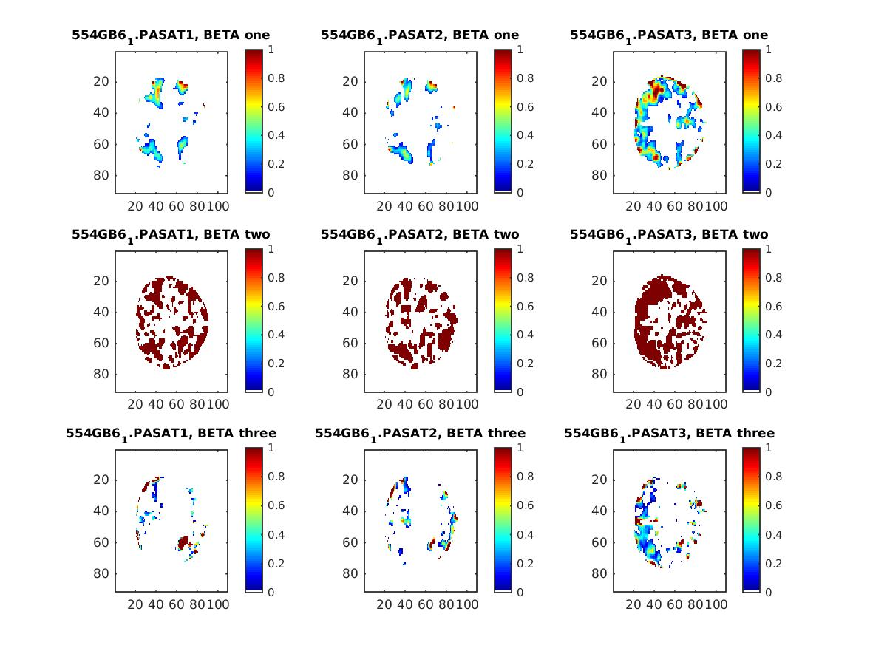

Slide 19
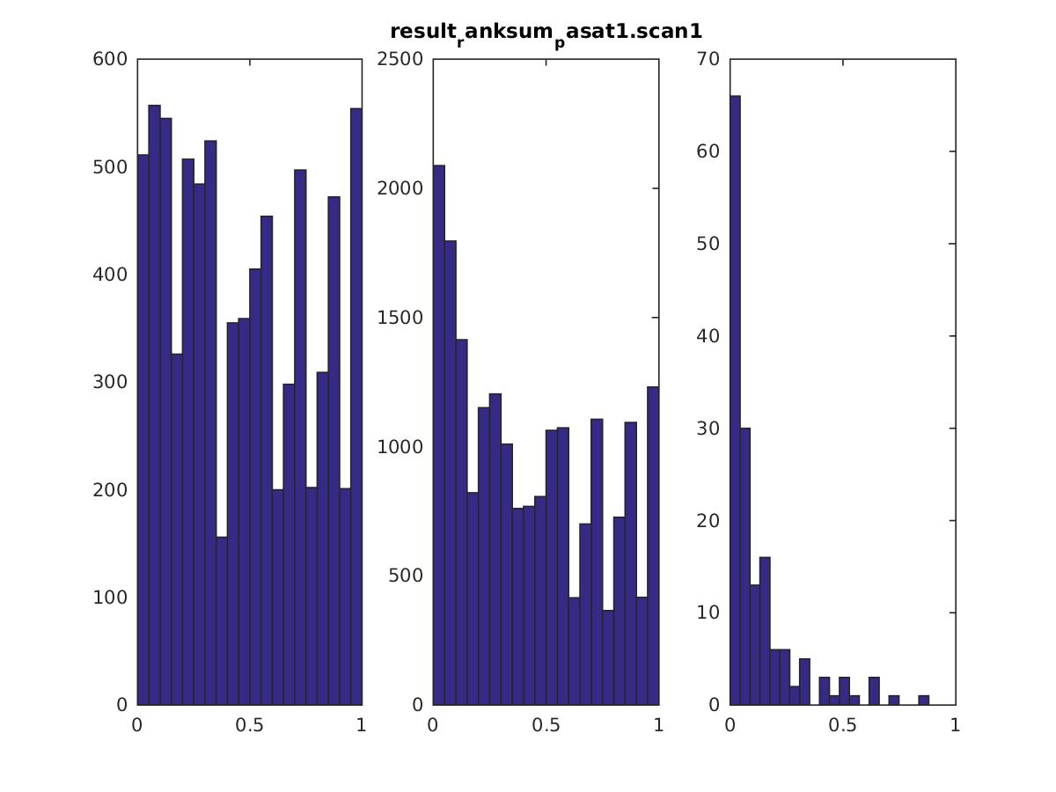

Slide 20
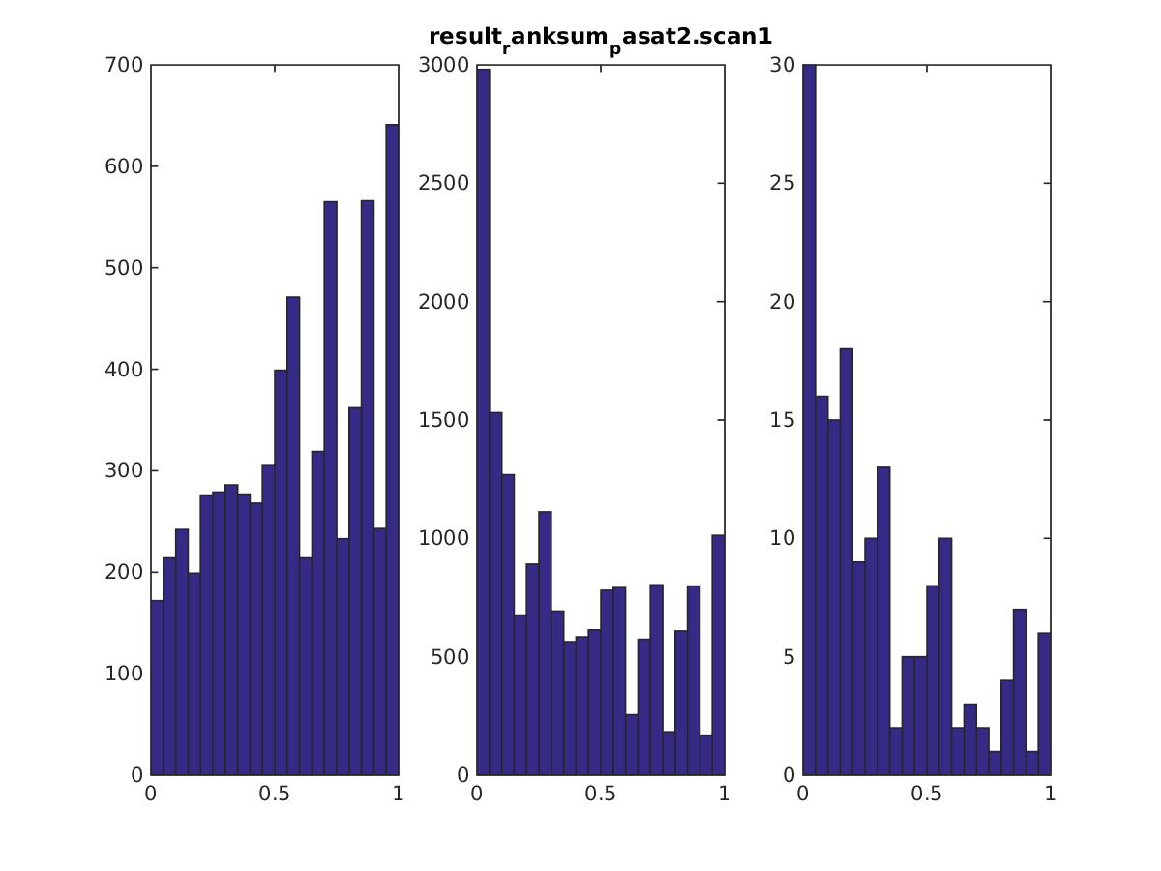

Slide 21
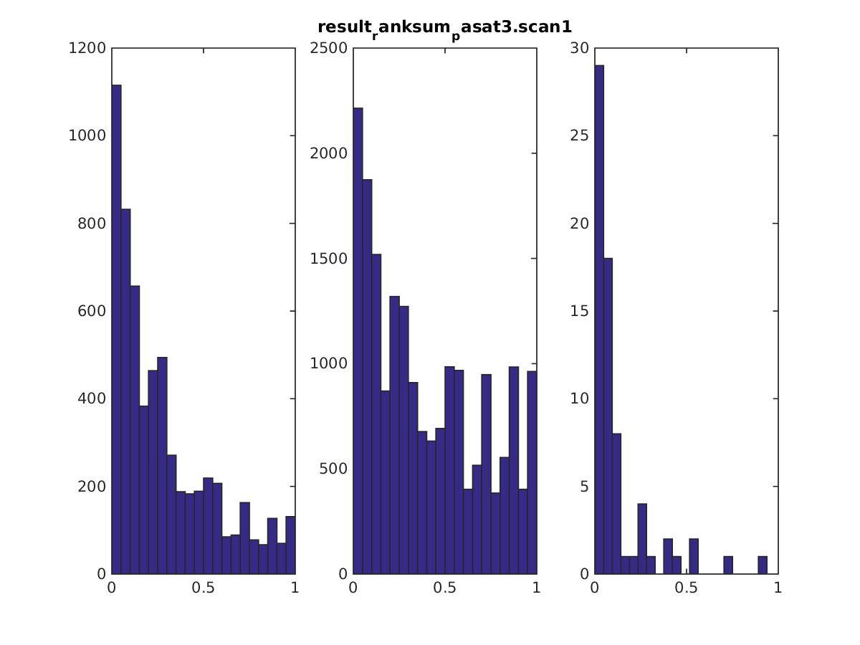

Slide 22
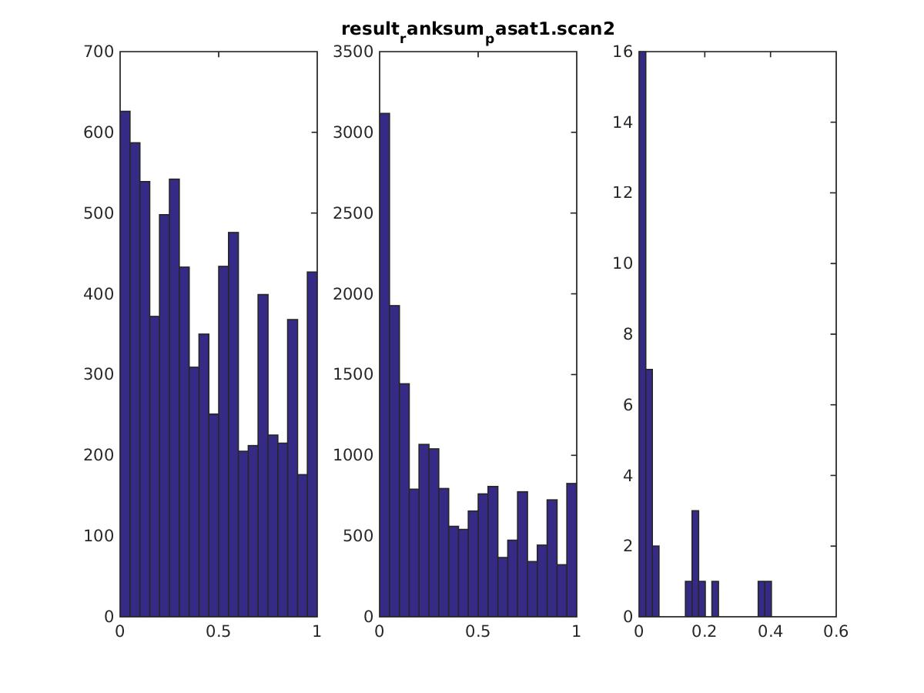

Slide 23
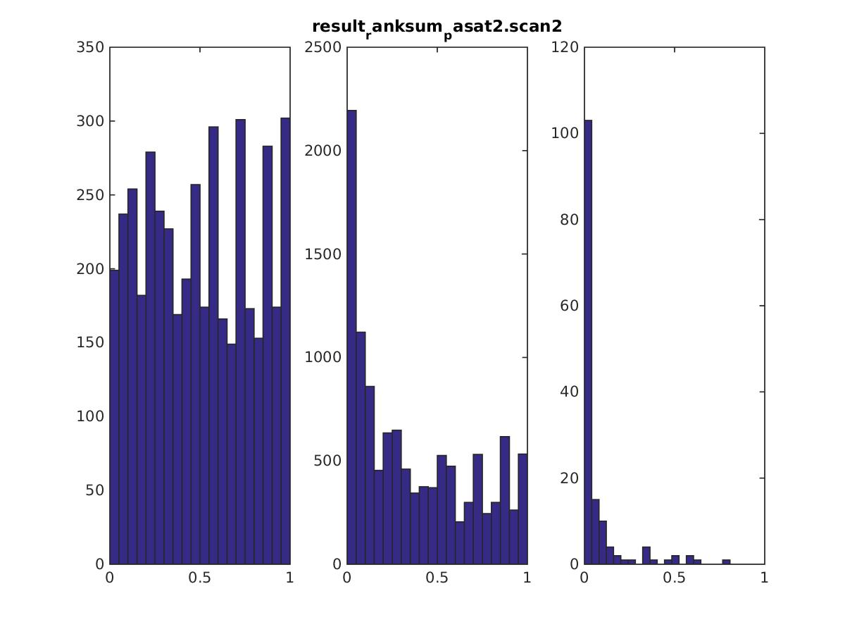

Slide 24
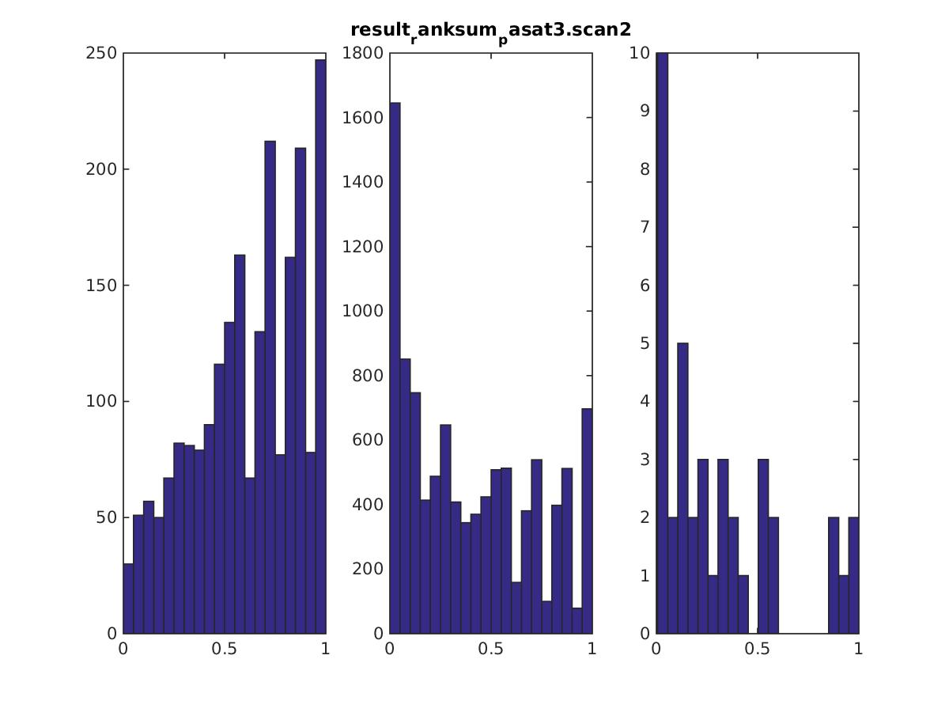

Slide 25
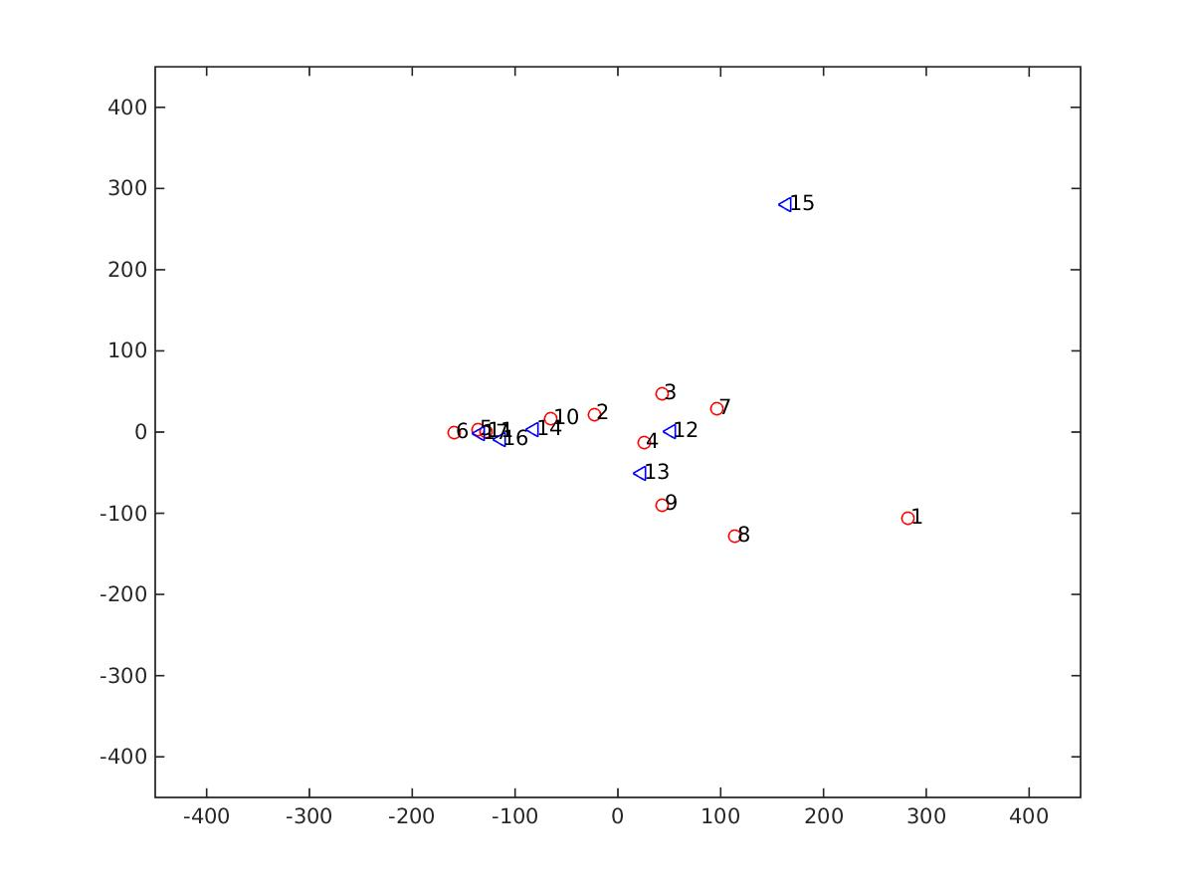
pasat 1 scan 1 beta 1

Slide 26
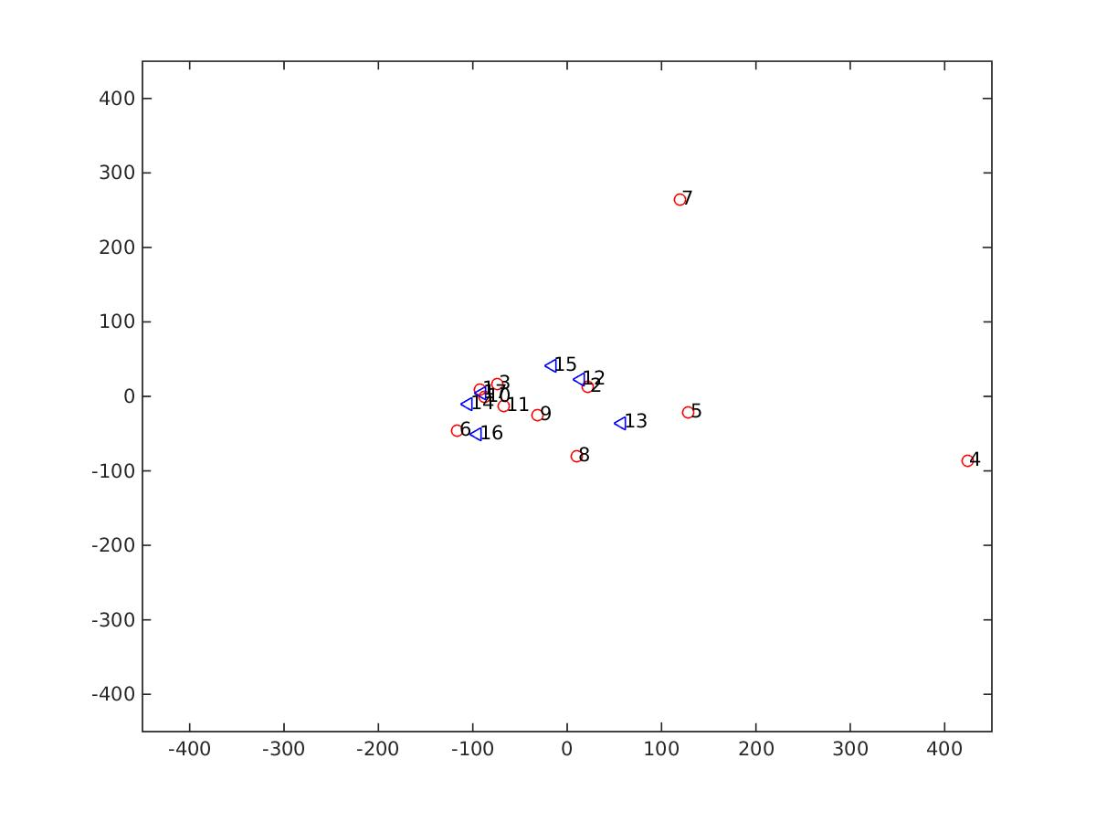
pasat 2 scan 1 beta 1
pasat 2 scan 1 beta 1

Slide 27
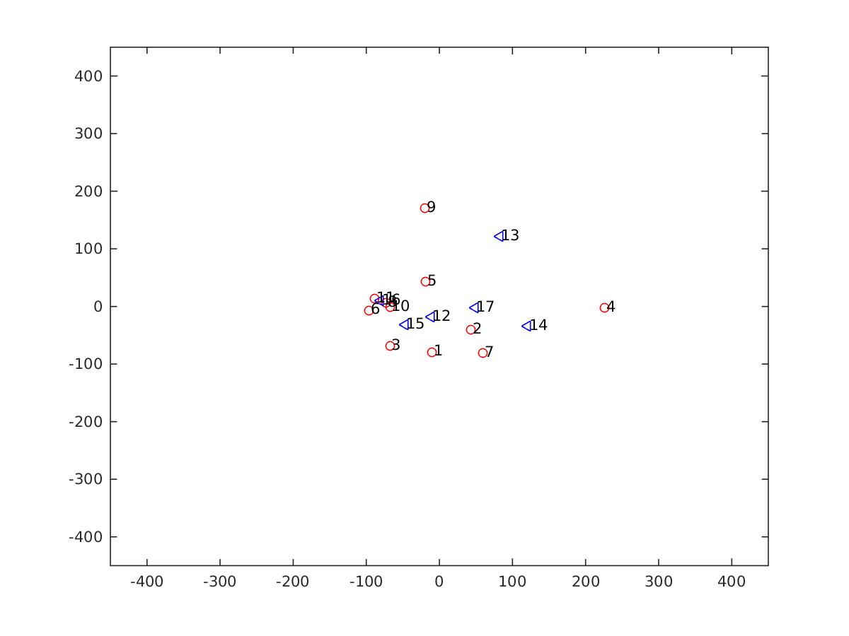
pasat 3 scan 1 beta 1
pasat 3 scan 1 beta 1

Slide 28
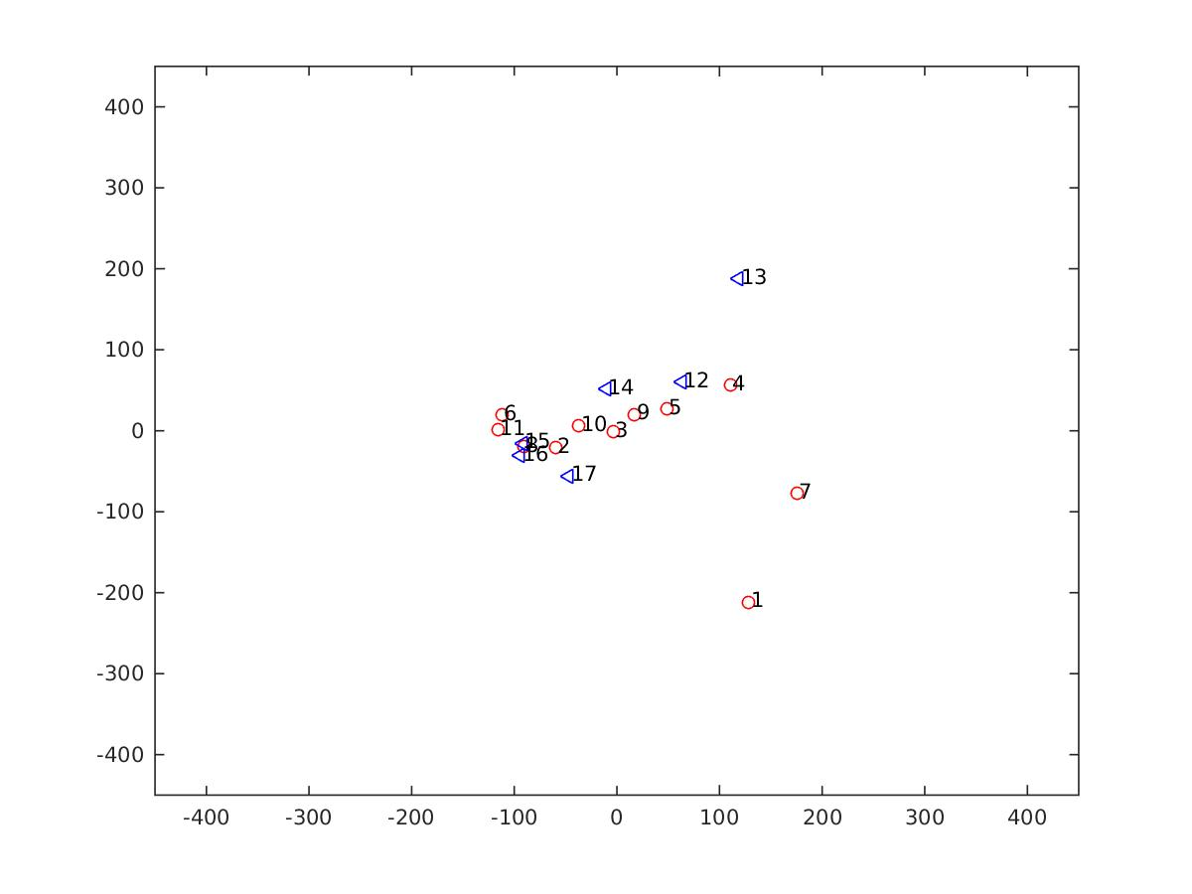
pasat 1 scan 2 beta 1
pasat 1 scan 2 beta 1

Slide 29
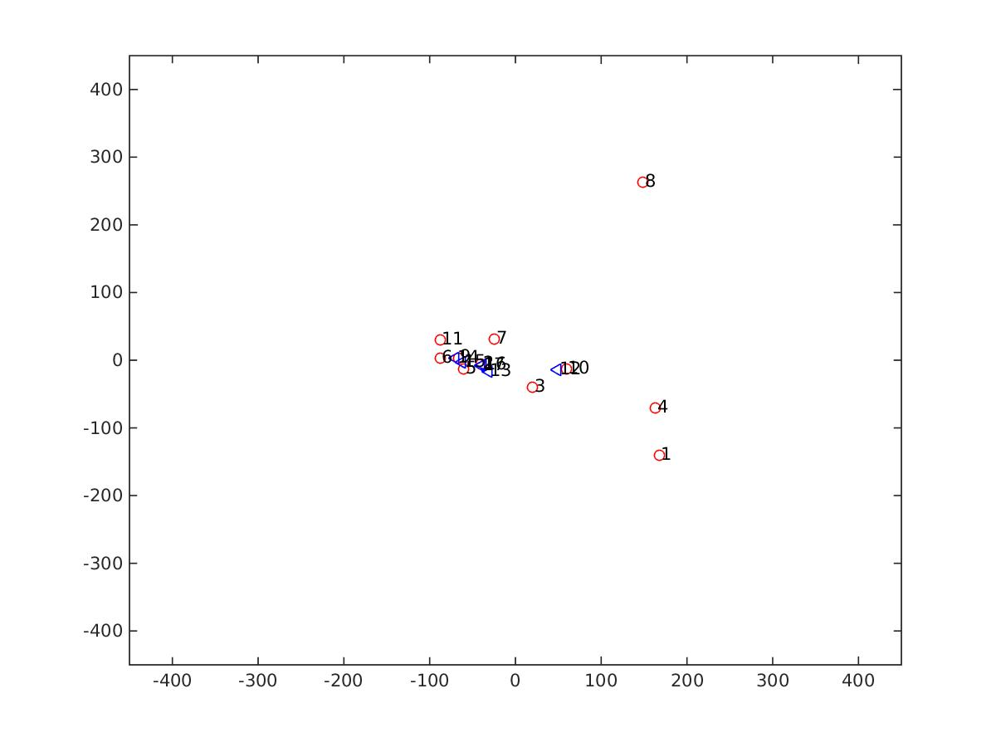
pasat 2 scan 2 beta 1

Slide 30
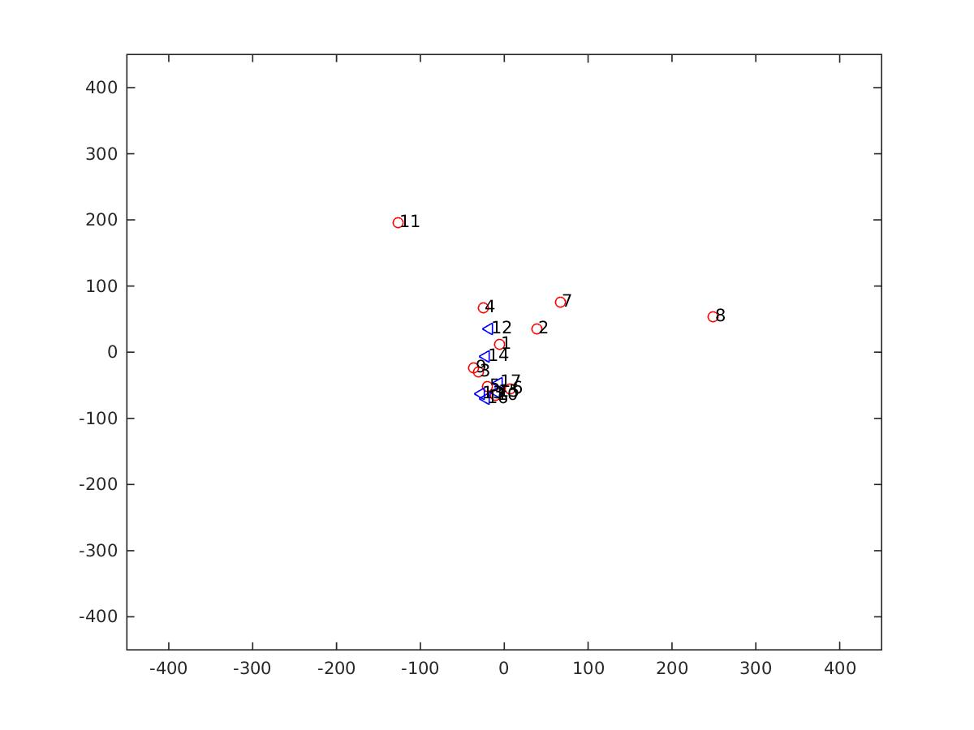
pasat 3 scan 2 beta 1

Slide 31
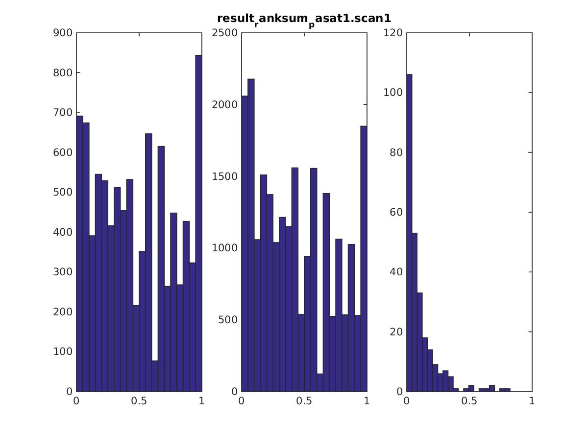
CFS #1 = 020VTV HC #15 = 487ZR9

Slide 32
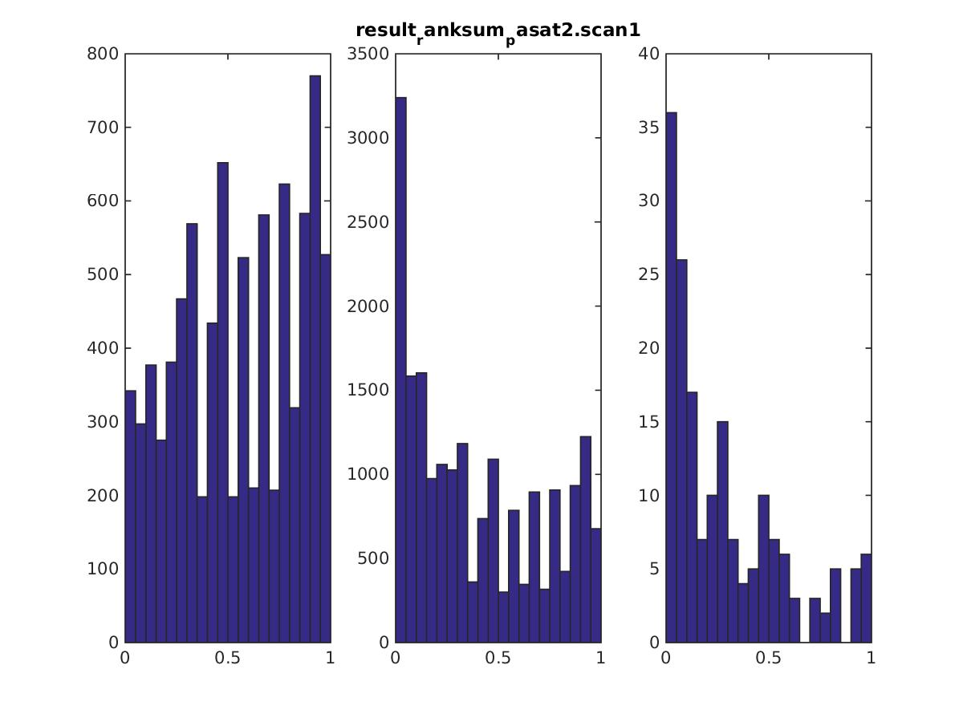
CFS #4 = 318LYO, #6 = 430EEN, #7 = 617KGL

Slide 33
CFS #4 = 318LYO

Slide 34
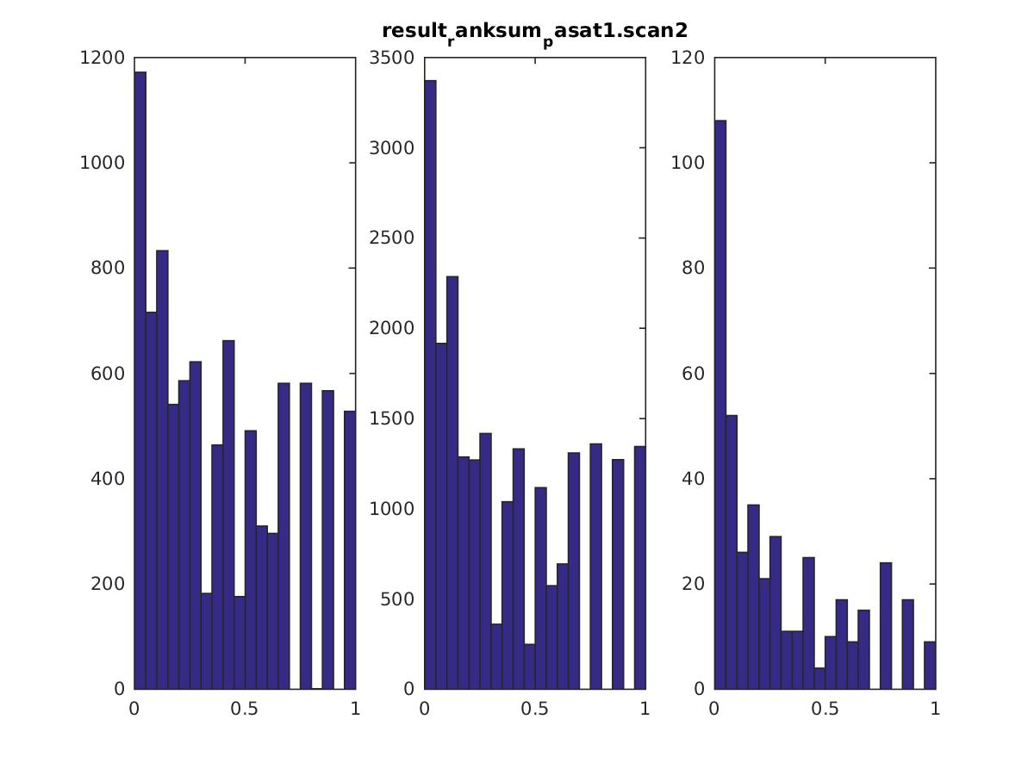
CFS #1 = 020VTV, #6= 617KGL HC #13 = 129EW1

Slide 35
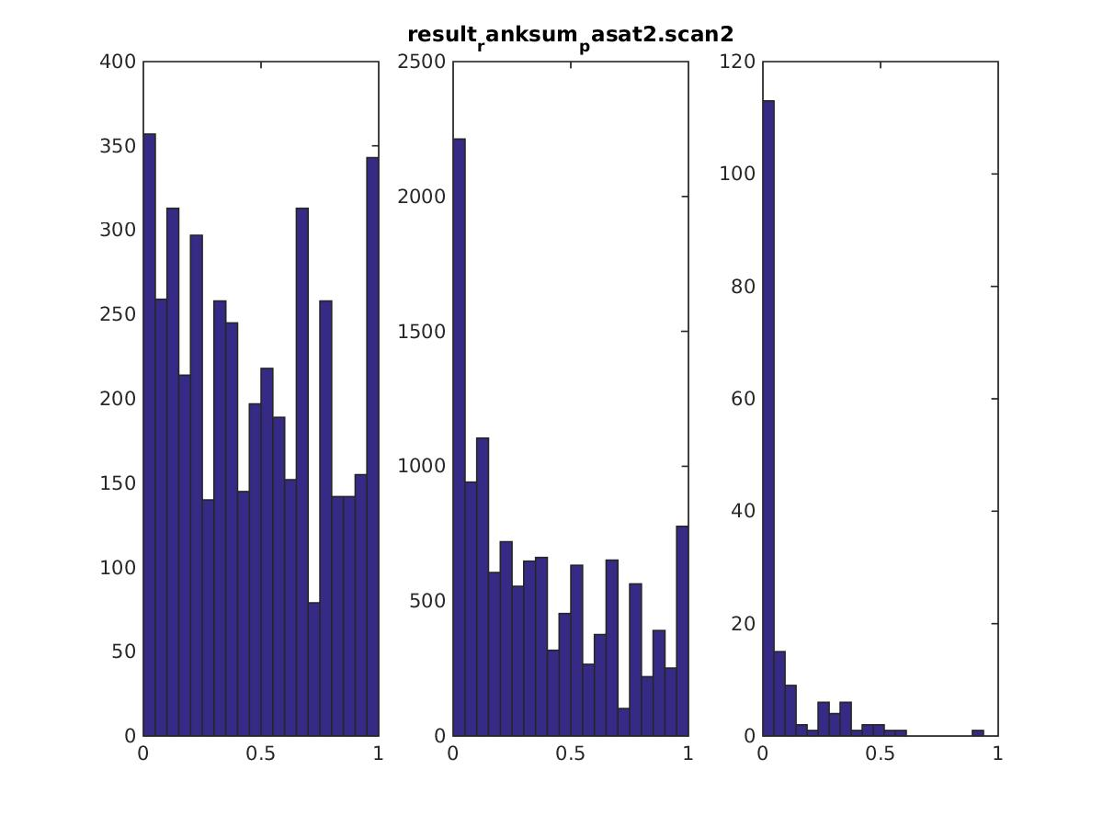
CFS #1 = 020VTV, #8 = 669YTH

Slide 36
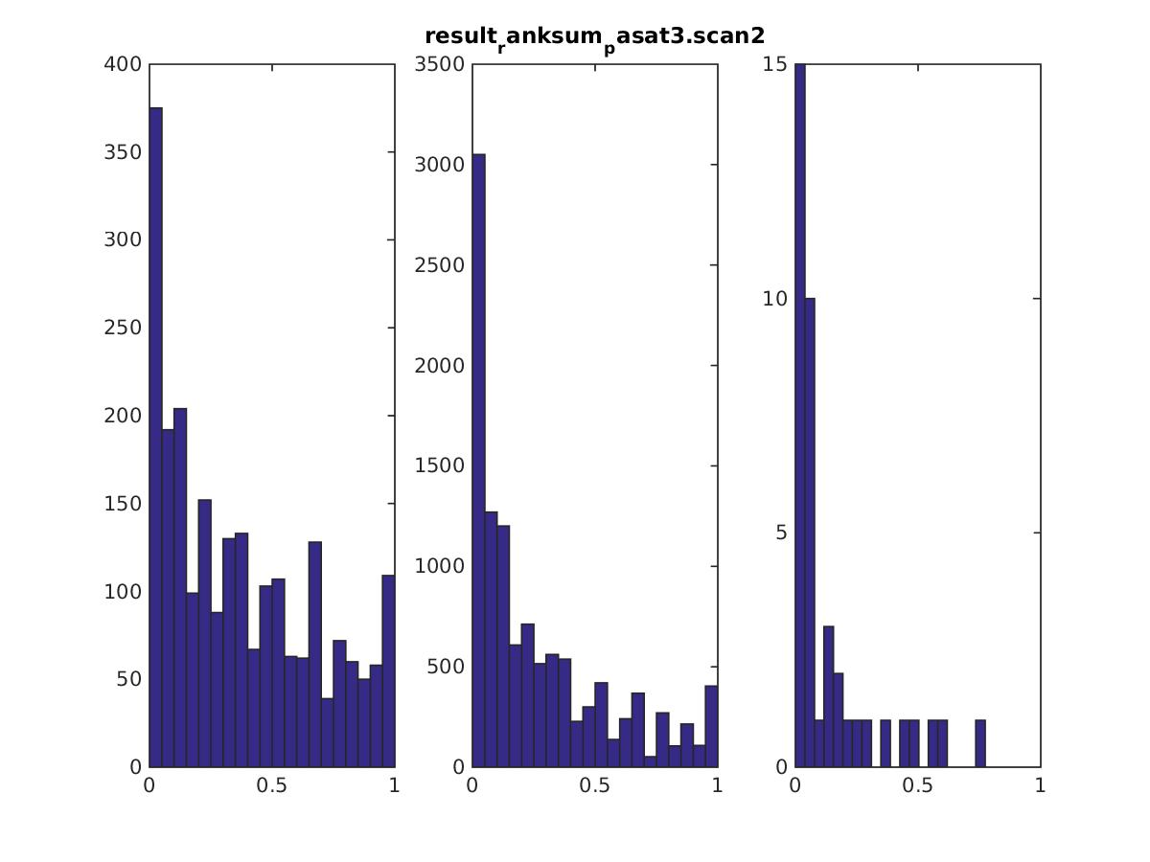
CFS #8 = 669YTH, #17 = 744GXX

Slide 37
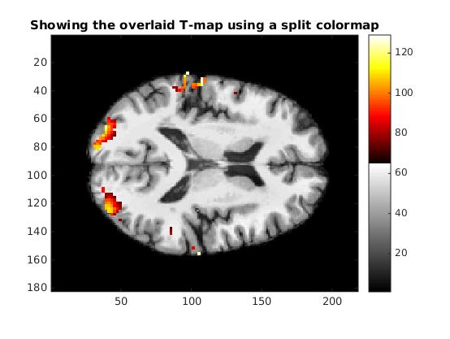

Slide 38


Slide 39
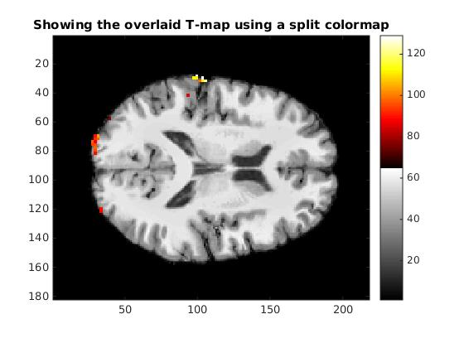

Slide 40


Slide 41
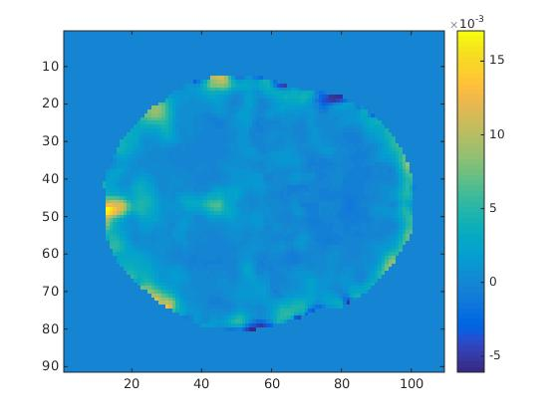

Slide 42
